Slide 1
Implementation of an Open-World Recognition-capable Network Intrusion Detection System
IOWR-NIDS
Client: Army Cyber Institute - Bastian, Nathaniel D LTC
Developers: Andrew Bajumpaa, Alexandre Broggi, Joseph O'Dowd

Slide 2
Network Packet Identification
Network packets need to be identified for the security of internal network systems. There are several methods for identifying these packets but with the advent of common Artificial Neural Networks (ANN), Machine Learning (ML) is a place that many turn to.
The issue with this is that ML can only identify items that it is has seen in training. This leaves models vulnerable to new types of network attacks.
Research has been going on attempting to use Open World Recognition to patch that vulnerability.

Slide 3
What is IOWR-NIDS
The Goals of the project are as follows:
Create an interface for using the OSR NIDS machine learning model from prior Open Set Recognition research.
Implement live packet reading for the created interface.
Packet storage from live reading.
Evaluate the effectiveness of the system.
Incorporate ongoing reliability and Open World Recognition research.

Slide 4
The Research
Open Set Recognition (OSR): Aims to classify things into any number of classifications. Useful when novel attacks appear on a network.
Resilience: Studies failures of a system, its recovery time, and recovery percentage.
Final Goal: Create an OSR enabled NIDS that recognizes its failure rate and can be retrained according to resilience analysis.

Slide 5

What was done by the Research
The research designed a CNN, Convolutional Neural Network model structure that performs a 1-dimensional convolution over the bit packets and then transitions into a fully connected Neural Network.
All packets are considered to be independent of each other and no recurrent nodes are used.
The Model then performs one of several Open Set Recognition algorithms to identify unknown packets from other packet classes.
Those being one of Energy-OOD, Competitive Overcomplete Output layers, and identifying inter and intra spread and sparation of data means.
Notes:
First, we would like to identify the model designed by the research before this project began.
The Model is a CNN, a convolutional neural network model that ends with a few fully connected layers. The final classifications from this model are then passed to one of several algorithms that attempt to identify datatypes that were unknown during training time.
We will mostly be using Energy OOD because that algorithm appeared best suited for this task during the reaserch phases but we can change between any of these algorithms easily if we find that a different algorithm is more suited to the task at hand.
In the Future of the research the packets classified by the algorithms as unknowns will be fed into a Large Language Model that will identify a possible new name for these packets. But as this system has only begun to be developed, it was not included in our MVP requirements.

Slide 6
What the Minimum Viable Product (MVP) is
A GUI system that displays packet information from premade files in a clear and readable manner.
Packet information including header data and content data must be displayed.
Connection with research-derived ML Models to predict classification data.
Basic visual network metrics showing what proportions of the traffic is each class.
Notes:
For this Project we will define a minimum viable product. A minimum viable product is defined as a working version of a project that is able to perform the required features of said project.
For this case, our minimum viable product is a GUI interface that displays packet information from either live capture or premade files. The interface must be able to have information about the packets such as header data including source and desitnation as well as content data.
In addition to that it must be able to connect to an internal Machine Learning Model based on existing Open Set Recognition Research. That model will classify the content data of the packet as benign, some catagory of malicious, or Unknown. The results of the model will be displayed alongside the header data within the GUI.
We will need to show the distributions of the data in a visual format.

Slide 7
What we have done
A user interface was prototyped with Figma and implemented with Dash.
A server was created to persist data and connect all the components.
The server inserts packet data from either live packet capture or pcap files into the database.
Instances of the model are spun up on the server per client demand.
Packets are analyzed the current instance of the model and classification prediction labels are inserted into the database.
The client interfaces with the server to retrieve pages of packets and data for tables and figures.
Notes:
Currently we have developed a web displayed user interface implemented using the python library dash. This interface connects to a SQL database that stores all packet and model information. New packet data is added to the database when it becomes avalible either through reading a file or live scans of the active network.
When packets are added to the database, they are analized with the current active model, if no such model exists, a model is trained from the training CIC IDS datasets.
When the web-based interface is refreshed it calls to the database and retrieves all current information. This process also rebuilds all of the graphical charts.

Slide 8
The Architecture
Send or Request
Request Only
Local/Same machine
Network Connection
Client
Data Loader
Network Feed
Model Loader
Database

Slide 9
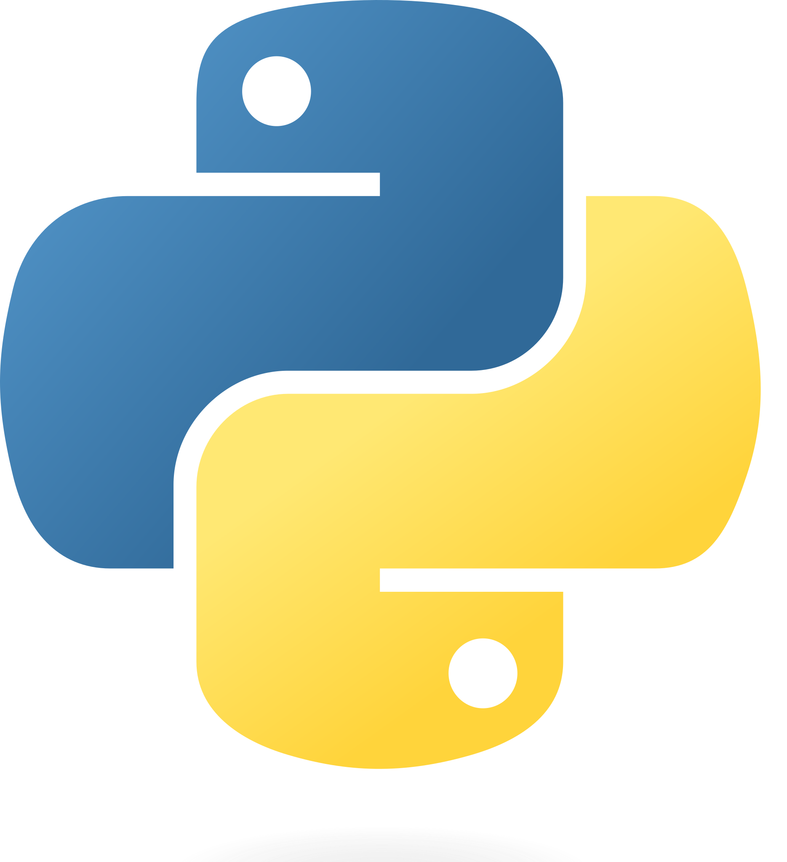




Applications and Resources Used
Python
Programming language with several Machine Learning libraries available, most of the project so far has been developed in python.
Payload-byte
Dataset that has extracted features from the CIC-IDS2017 pcap files.
Wireshark
External program used for collecting network packets. This project was using a library for the command line implementation called tShark.
PostgreSQL
Database used for storing information from incoming packets and from the attached neural network models.
Discord
Team communication application.
GitHub
Version control for code that allows the team to easily combine independent work.
PB
Notes:
Let us do a quick run down of all of the applications and resorces we used,
First, We mainly used the programming language python to develop the model and graphical interface code, due to its flexibility and avalible libraries.
Next we used Payload-byte, which is an online research code base that has orginized csv versions of pcap files found in the CIC-IDS dataset that are well formatted for model training.
We are collecting our own packets for the live collection using the program wireshark, specifically the interface for the termial version called tShark
That interfaces with our SQL code, specifically PostgreSQL. PostgreSQL is an SQL varient that is where we are storing all of our packet data.
We used Discord to communicate within the team and GitHub to store our code and version control.

Slide 10
Main Python Libraries Used
Pytorch for the Neural Network design and implementation.
Pandas for data-handling and selection.
Pytest for unit testing that identifies issues before they propagate.
Pyshark for interfacing with tShark and collecting network packets.
Dash for creating an interactive web-based display.
Pyro5 for linking instances of Dash to the data hander.

Slide 11
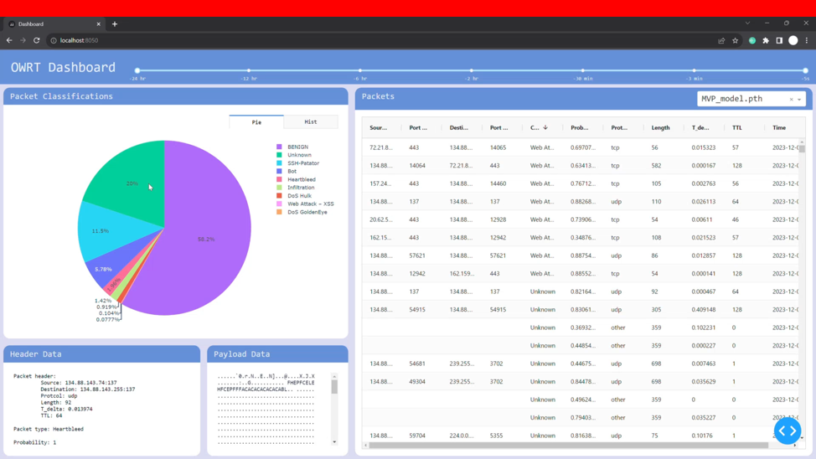
Demo

Slide 12
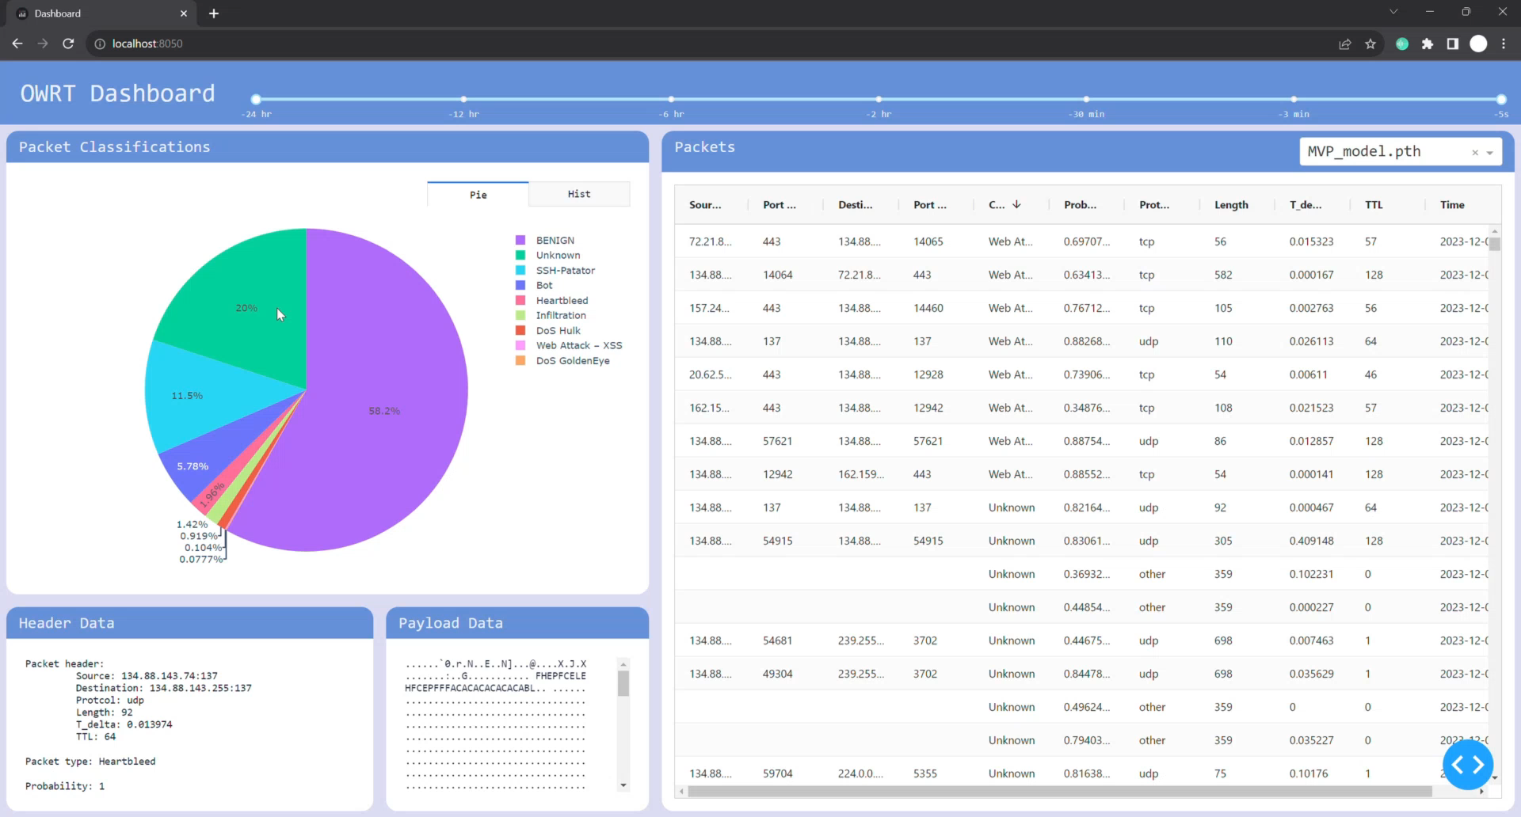
Demo (Video)

Slide 13
Why is this MVP?
We meet the base functionality requirements:
We collect internet packets from live sources.
Use Dash to implement a GUI for viewing packets.
The database is connected to a machine learning model instanced from a research-derived architecture.
Model predictions are made.
We have created a codebase that can expand to include the rest of the final requirements.
We have detailed the design of our system in numerous design documents so that it can be understood with minimal outside help.
Notes:
We beleive we have completed the MVP as described above by meeting all of the listed main requirements for the system.
Those being, Collect data, Use prior research to form labels, and Display data using a GUI
The code we have created is done in a way that it can be expanded to fufill the rest of the requirements for the final product more easily
We have also been keeping track of the design documentation so that our work is able to be understood by the end user or other associated programmers.

Slide 14
Future work
For future work, we hope to integrate more of the ongoing research as it is developed.
A model page will be added that will display information for each specific model and show how that model has performed on the training data.
We plan to have a method of saving new names for recorded packets so they can be used as training in the future.
We additionally will be using Docker to containerize our code for portability.
We will create quality assurance and usage documentation.

Slide 15
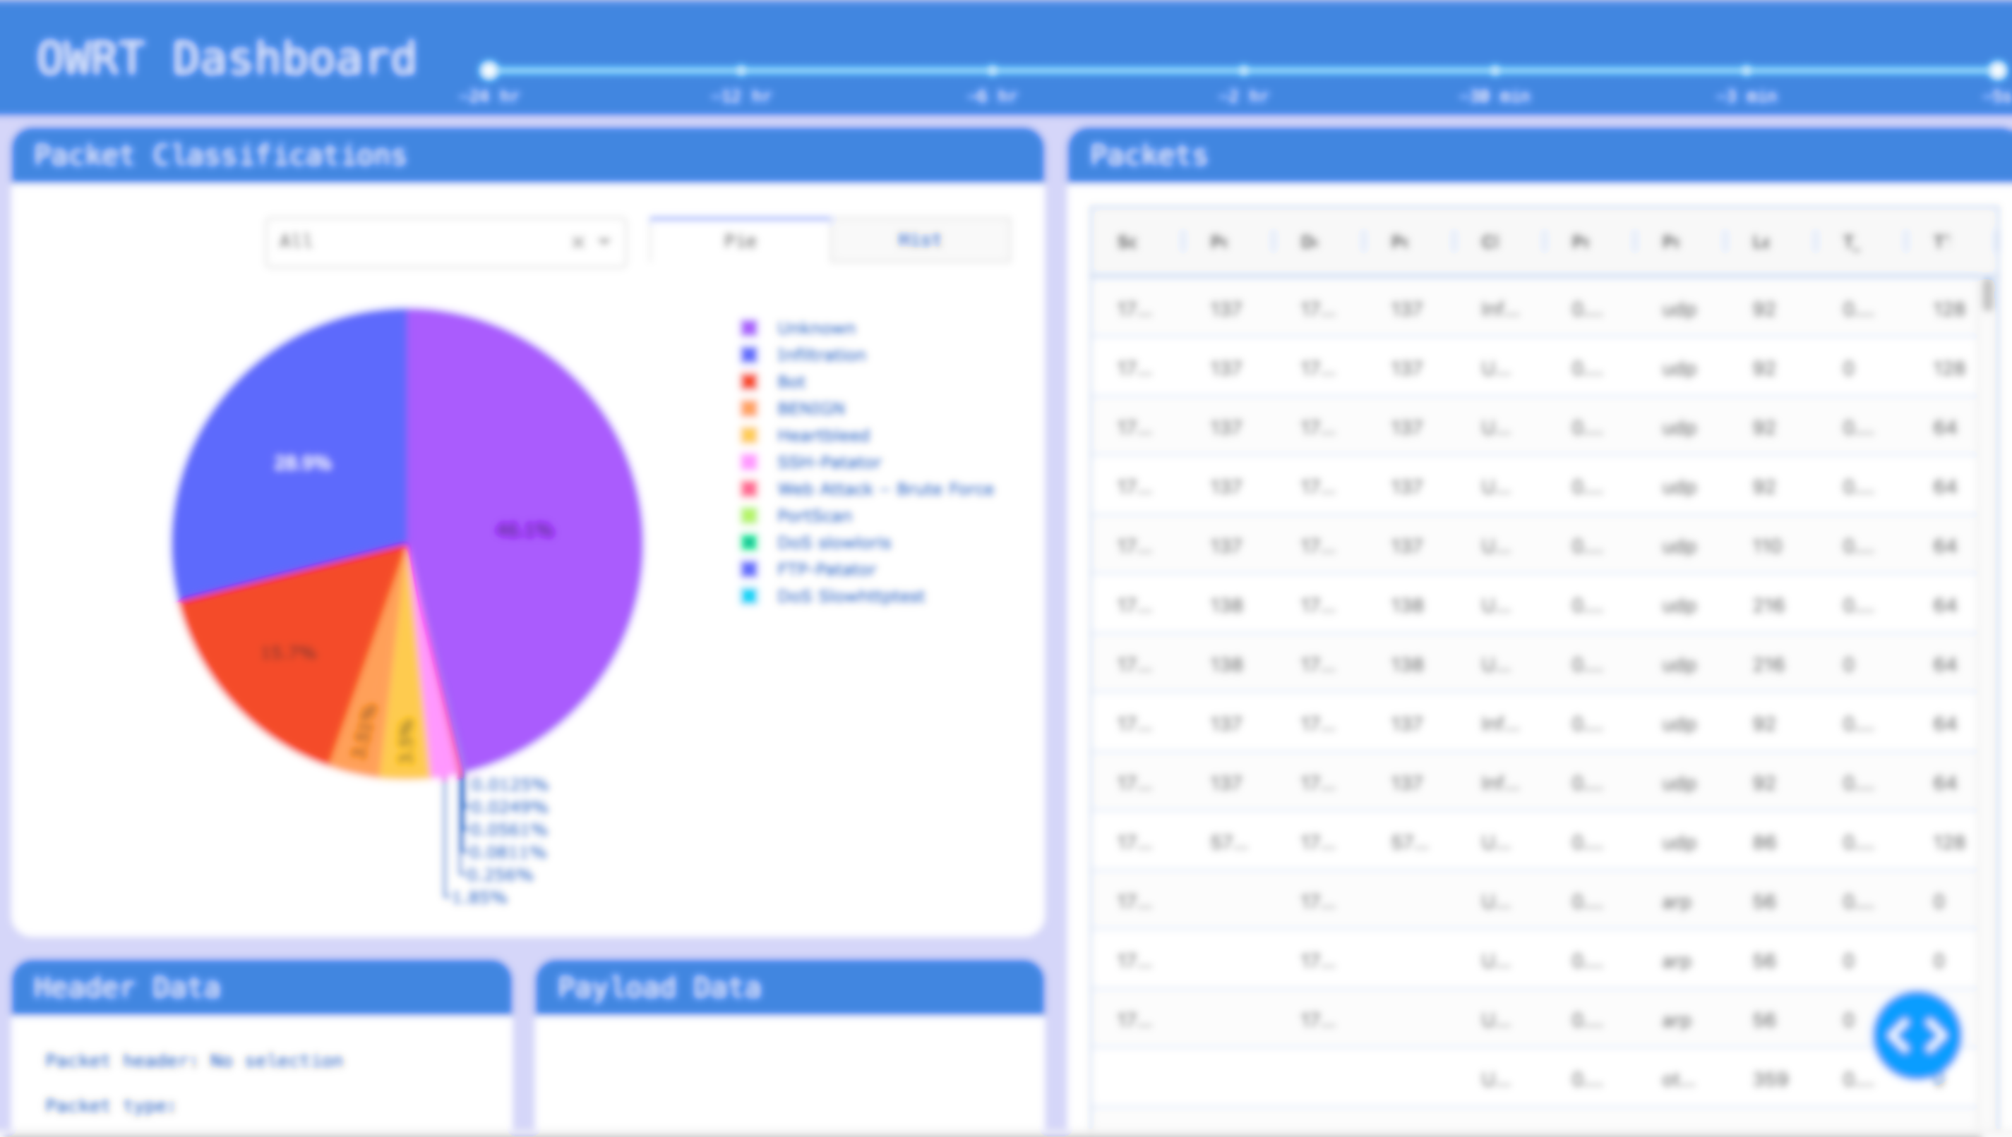
Questions?

